Slide 1
I can read a news article and identify feature of this written genre.
I can write my own human interest story.
https://eflsummerschool.wordpress.com

Slide 2
Mingling
Is ‘news’ important?
Do you read the news?
Have you read any news today?
What type of news do you usually read?
What type of stories interest you?
Have you read anything that made you angry, sad or happy?

Slide 3

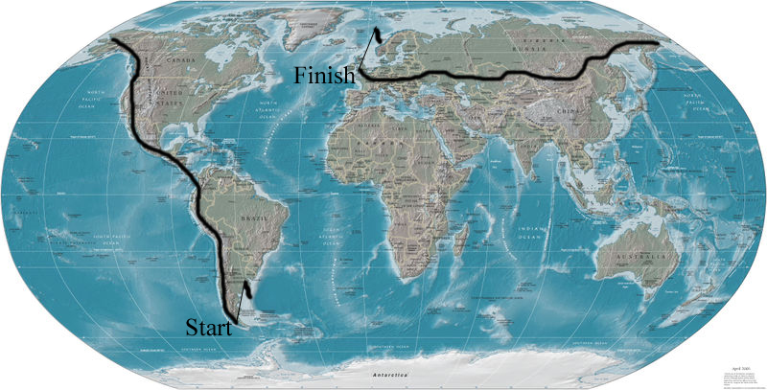



You are going to read a news article about a very unusual man.
Look at the pictures. What do you think he is doing? Tell your partner….

Slide 4











Before you read, use these words from the text to predict what you are going to read about. Tell your partner….

Slide 5

Now read the text

Slide 6
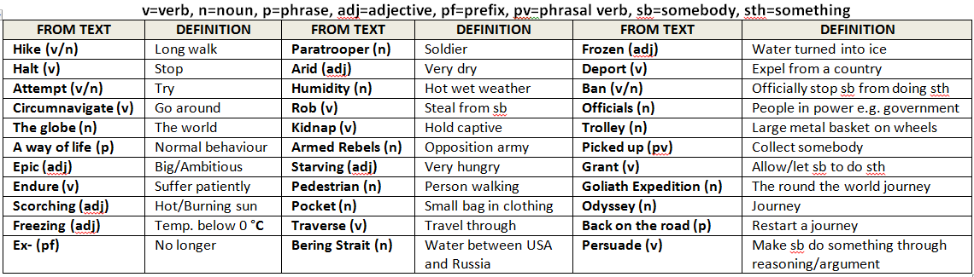
Synonyms

Slide 7
Questions
With your partner, answer the questions on your worksheet….

Slide 8
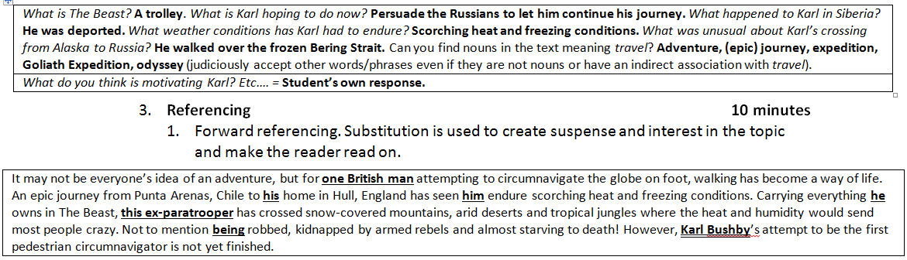
Answers

Slide 9
Video
Long clip: https://www.youtube.com/watch?v=LlRgHZu-Tkw
00:00 – 02:36: Introduction talks about the Bering Straits
02:43 – 03:43: Explains why Karl is doing this. Possible comprehension question, ‘listen to Karl talk about why he is walking around the world. Make notes about what he says’.
14:26 – 15:08: Crossing the Bering Straits

Slide 10
Text conventions
Look at the text again. What conventions can you see that are typically found in news article? For example, we always see a headline etc.
Tell your partner…

Slide 11
Text conventions
Look at the text again in more detail. These questions and prompts will guide you to see some more typical features of news articles. Discuss them with your partner…

Slide 12
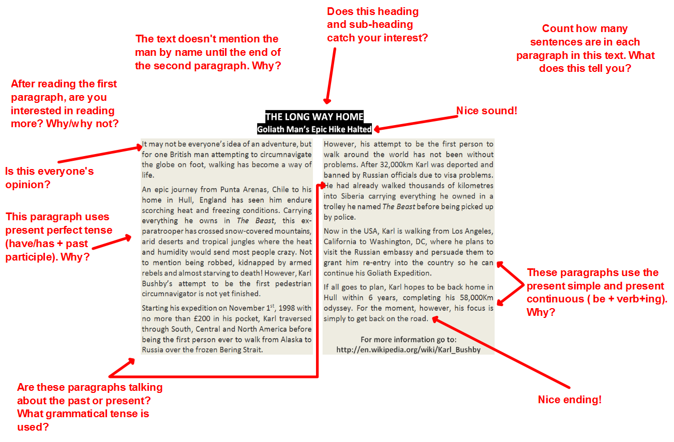
Text conventions

Slide 13
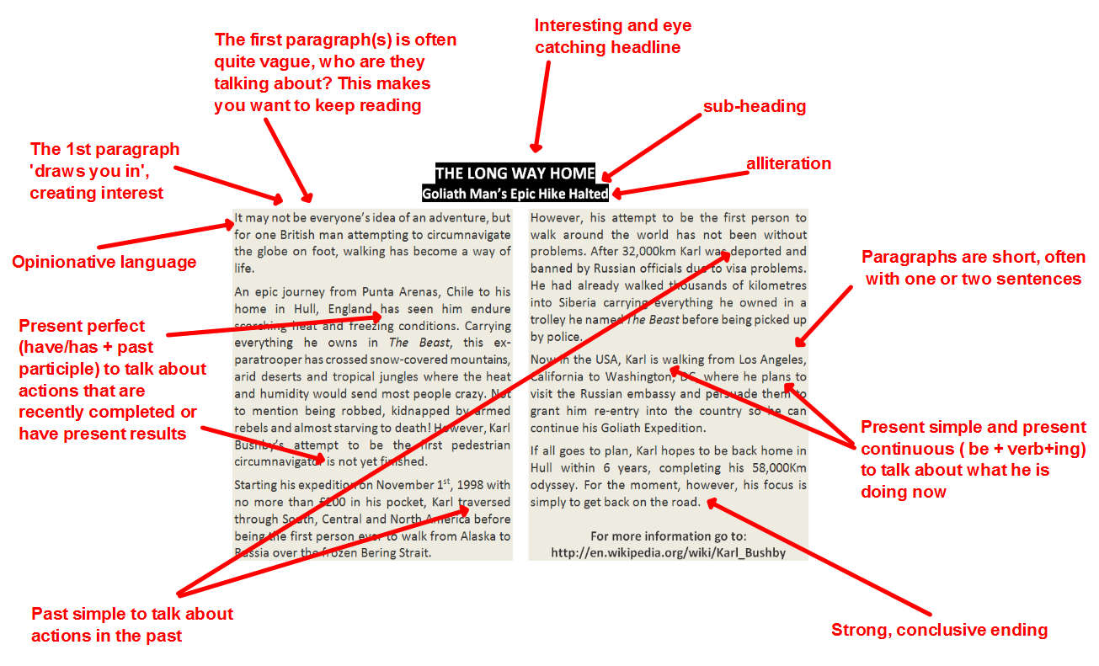
Text conventions

Slide 14
Write a human interest news story
Easier (see worksheet)
Manuel Ferreira from Lisbon
Very rich (millionaire)
Wants to go to space
Leaving in January
Medium
João Pedro da Gama from the Alentejo
Comes from a poor family
Won 1 million Euros on the M1lhão lottery
Dog ate his lottery ticket
More difficult
Name
From: town/region
Family/Background
What happened?
What was the problem?

Slide 15
Write a human interest news story
Now plan your writing in pairs.
When you have finished, write your text…

Slide 16
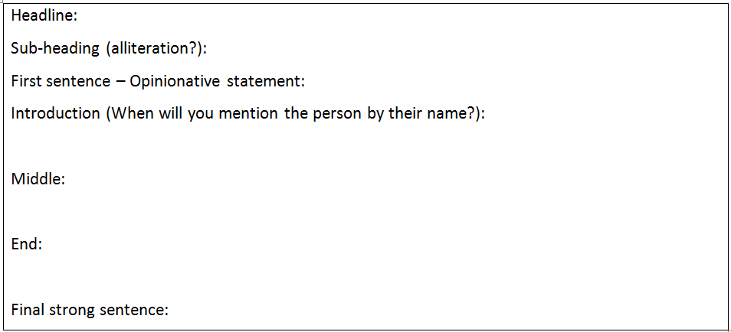
Write a human interest news story

Slide 17
Write a human interest news story
Swap your texts and look at the questions at the bottom of the page.
Answer the questions and then give your partner some feedback…

Slide 18
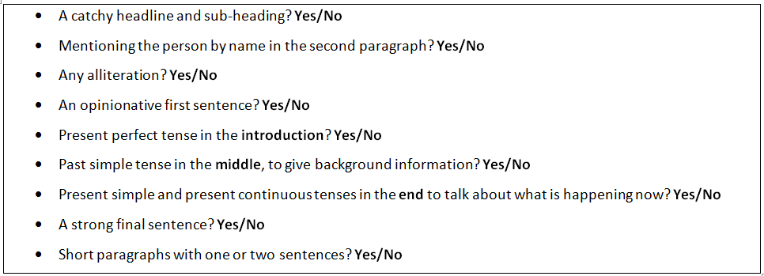
Write a human interest news story

