Slide 1
Reading skills

Slide 2
Lead in:
Discuss these questions:
What are reading skills?
How can we help our learners:
  Read better?
  Deduce the meaning of new words in context?

Slide 3
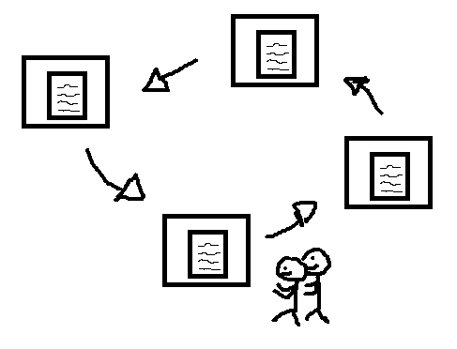
Activity 1:
Around the room there are stations with different activities.
In pairs or small groups, visit each station and work through the activities.
When you have finished, sit down once again.

Slide 4
The bus driver:
The bus came off the road and smashed through the fence of a local park eventually coming to a stop upside down next to a tree. Several passengers were hurt.
The driver was questioned by the police.
(Adapted from Nutall, C (I996). Teaching Reading Skills in a foreign language. Macmillan Heinemann (pp7-8)).
what happened next?
Why was the driver questioned by the police?
did you assume the driver was male?
Did you also assume that the driver was responsible for the crash or at least at fault?
She (the driver) was later congratulated on her quick thinking and skillful handling of the bus when the brakes failed.
Before knowing the full story, what did you assume and why?
What does this say about how we read?

Slide 5
Understanding Czech:
George W. Bush je prezidentem Spojených států amerických. Byl zvolen roku 2000 a převzal úřad po Billu Clintonovi. Byl znovu zvolen roku 2004. Narodil se v roce 1946. Jeho ženou je Laura Bushová. Mají dvě dcery, Jennu a Barbaru.
(Adapted from: Thornbury, S. (2006). An A-Z of ELT. Macmillan Heinemann (pp41)).
These text are written in Czech. They essentially give the same information but about two different people, George w. bush, the former president of the USA and arturs kriŠjānis kariņš, the prime minister of Latvia.
are you able to read and understand both texts?
Arturs Krišjānis Kariņš je premiér Lotyšska. Byl zvolen roku 2019 a převzal úřad po Mārisi Kučinskisovi. Dne 11. dubna 2019 přestál hlasování o důvěře. Narodil se v roce 1964. Jeho ženou je Anda Kariņa. Mají čtyři děti, Otomārse Krišjānise, Kārlise Vilhelmse, Māru Aleksandru a Annu.
Even though you probably cannot read and write in Czech, You may find that the text about George W. Bush is easier to understand. Why?
What does this say about the reading process?
Translation: Kamila Linková. kamilaofprague.wordpress.com @kamilaofprague

Slide 6
Paris:
How does this make you feel?
PARIS IN THE
THE SPRING
Most people:
Do not notice the extra the.
Look at the sentence holistically and draw on their world knowledge to form a mental picture of what Paris might be like in the spring.
If you didn’t notice the extra the, you were reading the sentence differently to someone who did see it. What is this difference?
What does this say about how we read?

Slide 7
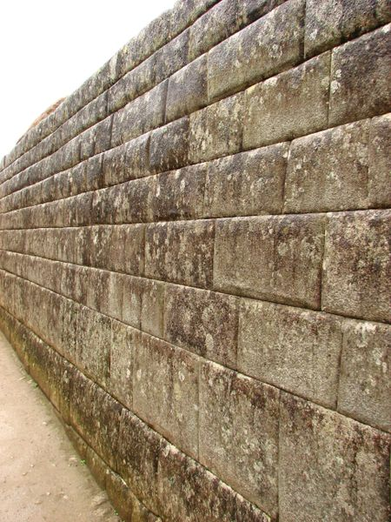
Joke 1:
(Picture: By Rubyk - en.wiki w:Image:Perfectwall.jpg. Uploaded to Commons by JackyR, 2006-05-23, CC BY-SA 2.5, https://commons.wikimedia.org/w/index.php?curid=803501).
Do you understand this joke? If not, why?
What elements may challenge your learners? Remember this may not only be a linguistic challenge.
1. l can't get over it, can you?
2. What?
1. That ten metre wall!
This joke is accessible to a wide audience as it holds no cultural connotations. The meaning is purely linguistic.
It is a play on get over, which like many multi-word verbs, is polysemic.
In the first sentence, the inferred meaning is, recover, while the final sentence changes the inference to mean overcome or more specifically, climb over a wall.

Slide 8

Joke 2:
Do you understand this joke? If not, why?
What elements may challenge your learners? Remember this may not only be a linguistic challenge.
1. He's a bit of a dark horse, isn't he?
2. Who?
1. Black Beauty!
This joke may be inaccessible as the challenge is not purely linguistic.
Learners would need:
To know the noun phrase, a dark horse meaning, someone with a secret, especially a secret ability, skill, or achievement, that surprises you when you finally discover it. (Definition from: https://www.macmillandictionary.com/dictionary/british/dark-horse).
To be aware of, Black Beauty, a novel about a dark horse by Anna Sewell. Picture: By Unknown - Public Domain, https://commons.wikimedia.org/w/index.php?curid=5133393

Slide 9
Joke 3:
Do you understand this joke? If not, why?
What elements may challenge your learners? Remember this may not only be a linguistic challenge.
1. He got his own way, didn't he?
2. Who?
1. Clive Sullivan!

Slide 10
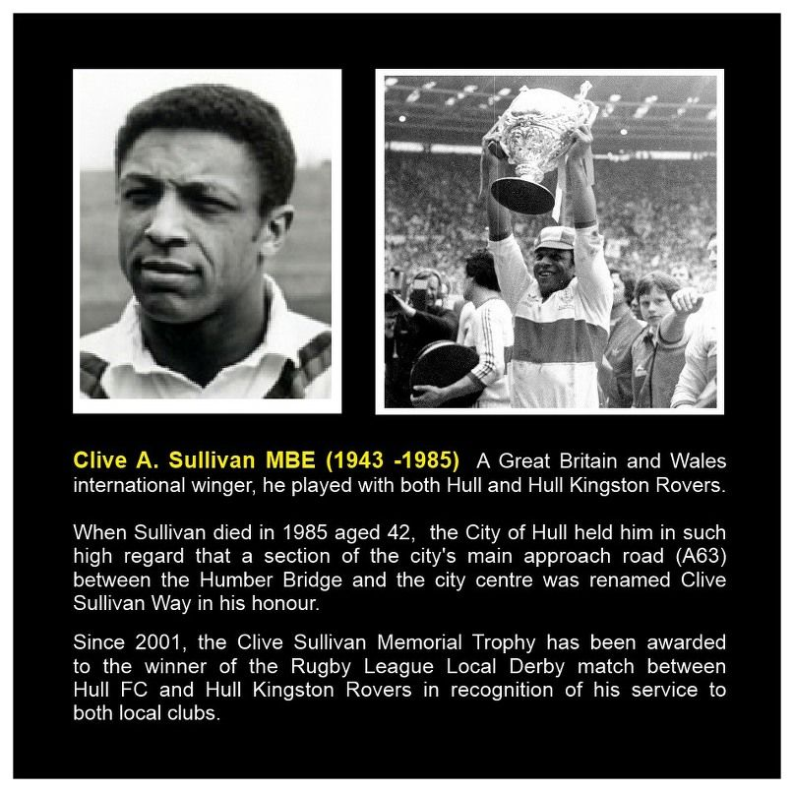
Joke 3:
1. He got his own way, didn't he?
2. Who?
1. Clive Sullivan!
This joke will be inaccessible to most learners as the challenge is not purely linguistic.
They would need:
To know the verb phrase, get your own way, meaning to persuade other people to allow you to do what you want. (Definition from: https://dictionary.cambridge.org/dictionary/english/get-your-own-way)
To know that, way, like avenue, boulevard and lane, can be used in street names as well as more typical words such as road.
To be aware of, Clive Sullivan, a Welsh rugby league footballer who played for Hull and Hull Kingston Rovers. Sullivan was, and still is, revered and respected by the people from the city of Hull, England. So much so that the main road leading into the city now bears his name, The Clive Sullivan Way.
Image source: https://images.app.goo.gl/fBd9s2QGWETvZoGH6

Slide 11
Word attack:
Read this sentence.
can you guess what the words sploony urdles might mean?
Is there anything in the context which might help you deduce the meaning?
The sploony urdels departed.
(Source: Nutall, C (I996). Teaching Reading Skills in a foreign language. Macmillan Heinemann (pp69)).

Slide 12
Articles require a noun.
Looks like an adjective: ‘y’ ending.
Adjectives usually go before nouns.
Looks like a verb: ‘ed’ ending.
Looks like a plural noun: ‘s’ ending.
The sploony urdels departed.
Remember, sploony urdels are not real words!
Article + adjective + noun + verb
Looks like an intransitive verb: no object.
Article + noun + adverb + verb
Article + noun + noun + verb
Could be noun + adverb, e.g. The ‘car soon’ departed.
What can depart? People, cars etc.?
Could be noun + noun, e.g. The ‘Queen Mary’ departed.

Slide 13
Word attack:
Now take the same approach from the last exercise with this sentence.
Read the sentence.
can you guess what the missing words might be?
Is there anything in the context which might help you deduce the meaning?
‘.....as the sun came up on the _____ _____ , he could see the house in the distance.’
‘.....as the sun came up on the misty moor, he could see the house in the distance.’

Slide 14
Word attack:
‘Y’ in ‘misty’ is a common adjective ending.
‘.....as the sun came up on the misty moor, he could see the house in the distance.’
the + adjective + noun
We can try to guess the meaning using these words. We might be able to tell that ‘moor’ is something outside.

Slide 15
Word attack:
He wished he hadn’t left and gone off on his own. The others were right, it was a long way to travel and too much of a risk, especially as this type of wild open landscape had many dangers: wild animals, sharp dangerous rocks, which stuck out of the ground waiting for you to stumble over in the dark and fall on, not to mention the cold, the horrible biting cold. He could no longer feel his hands as he shivered under a blanket to keep warm. This made him feel more vulnerable than he had ever felt in his life.
As the sun came up on the misty moor, he could see the house in the distance. Had it been there in front of him all this time? He had walked through the night until he was too weary to go any further, but to think it had been there all along? Straight in front of him and no more than a mile away! The feeling of vulnerability, which had been made worse by the moor’s desolate landscape, had suddenly been replaced by a sense of safety that everything was going to be alright. He had been warned that the moor was particularly cold at this time of year and sensing the need to keep warm, he got up, packed his things and walked towards the house.

Slide 16
Word attack:
He wished he hadn’t left and gone off on his own. The others were right, it was a long way to travel and too much of a risk, especially as this type of wild open landscape had many dangers: wild animals, sharp dangerous rocks, which stuck out of the ground waiting for you to stumble over in the dark and fall on, not to mention the cold, the horrible biting cold. He could no longer feel his hands as he shivered under a blanket to keep warm. This made him feel more vulnerable than he had ever felt in his life.
As the sun came up on the misty moor, he could see the house in the distance. Had it been there in front of him all this time? He had walked through the night until he was too weary to go any further, but to think it had been there all along? Straight in front of him and no more than a mile away! The feeling of vulnerability, which had been made worse by the moor’s desolate landscape, had suddenly been replaced by a sense of safety that everything was going to be alright. He had been warned that the moor was particularly cold at this time of year and sensing the need to keep warm, he got up, packed his things and walked towards the house.

Slide 17
Word attack:
He wished he hadn’t left and gone off on his own. The others were right, it was a long way to travel and too much of a risk, especially as this type of wild open landscape had many dangers: wild animals, sharp dangerous rocks, which stuck out of the ground waiting for you to stumble over in the dark and fall on, not to mention the cold, the horrible biting cold. He could no longer feel his hands as he shivered under a blanket to keep warm. This made him feel more vulnerable than he had ever felt in his life.
As the sun came up on the misty moor, he could see the house in the distance. Had it been there in front of him all this time? He had walked through the night until he was too weary to go any further, but to think it had been there all along? Straight in front of him and no more than a mile away! The feeling of vulnerability, which had been made worse by the moor’s desolate landscape, had suddenly been replaced by a sense of safety that everything was going to be alright. He had been warned that the moor was particularly cold at this time of year and sensing the need to keep warm, he got up, packed his things and walked towards the house.

Slide 18
Word attack:
He wished he hadn’t left and gone off on his own. The others were right, it was a long way to travel and too much of a risk, especially as this type of wild open landscape had many dangers: wild animals, sharp dangerous rocks, which stuck out of the ground waiting for you to stumble over in the dark and fall on, not to mention the cold, the horrible biting cold. He could no longer feel his hands as he shivered under a blanket to keep warm. This made him feel more vulnerable than he had ever felt in his life.
As the sun came up on the misty moor, he could see the house in the distance. Had it been there in front of him all this time? He had walked through the night until he was too weary to go any further, but to think it had been there all along? Straight in front of him and no more than a mile away! The feeling of vulnerability, which had been made worse by the moor’s desolate landscape, had suddenly been replaced by a sense of safety that everything was going to be alright. He had been warned that the moor was particularly cold at this time of year and sensing the need to keep warm, he got up, packed his things and walked towards the house.

Slide 19
Lead in:
Out of interest, when you imagined a moor, what mental image did you have?

Slide 20
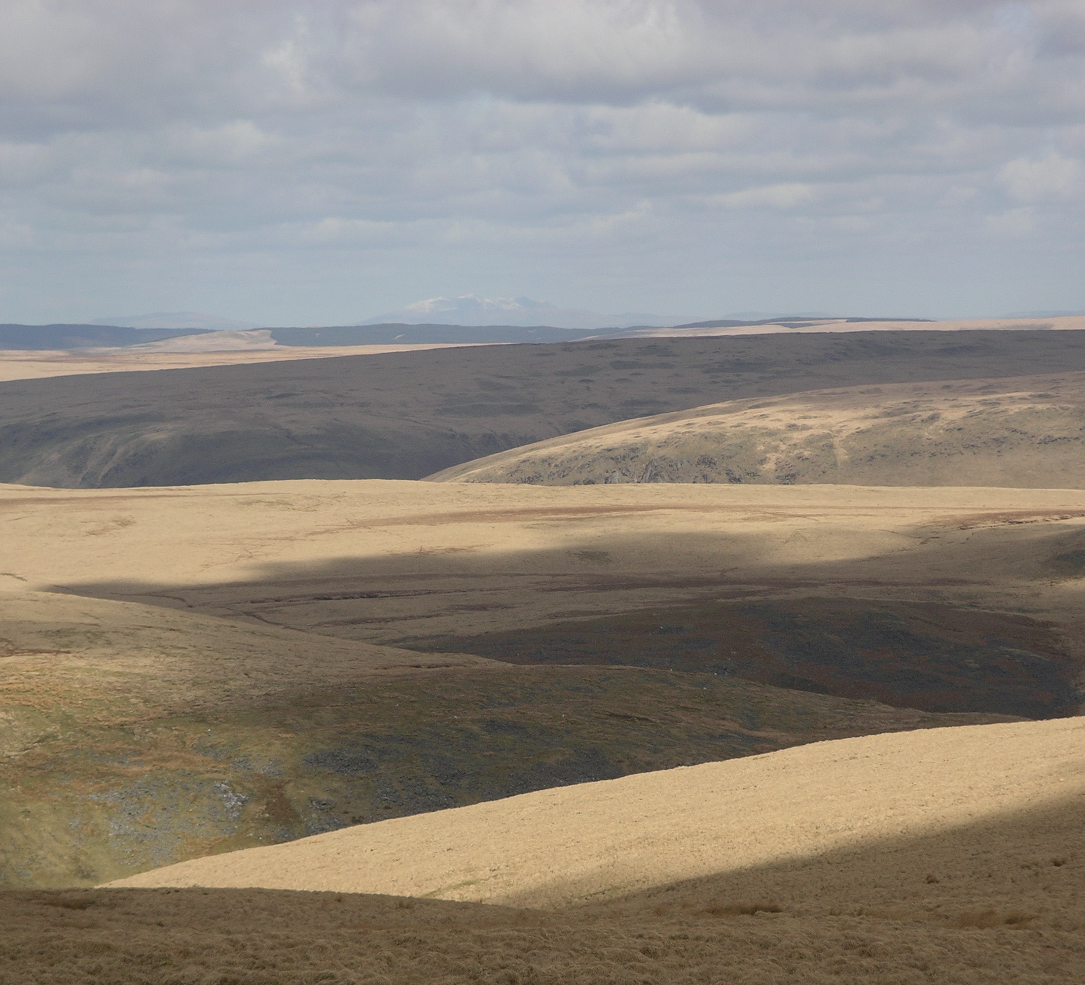
WAS IT THIS?
(Source: By: Velela - Own work, CC BY-SA 3.0, https://commons.wikimedia.org/w/index.php?curid=6426018 ).

Slide 21
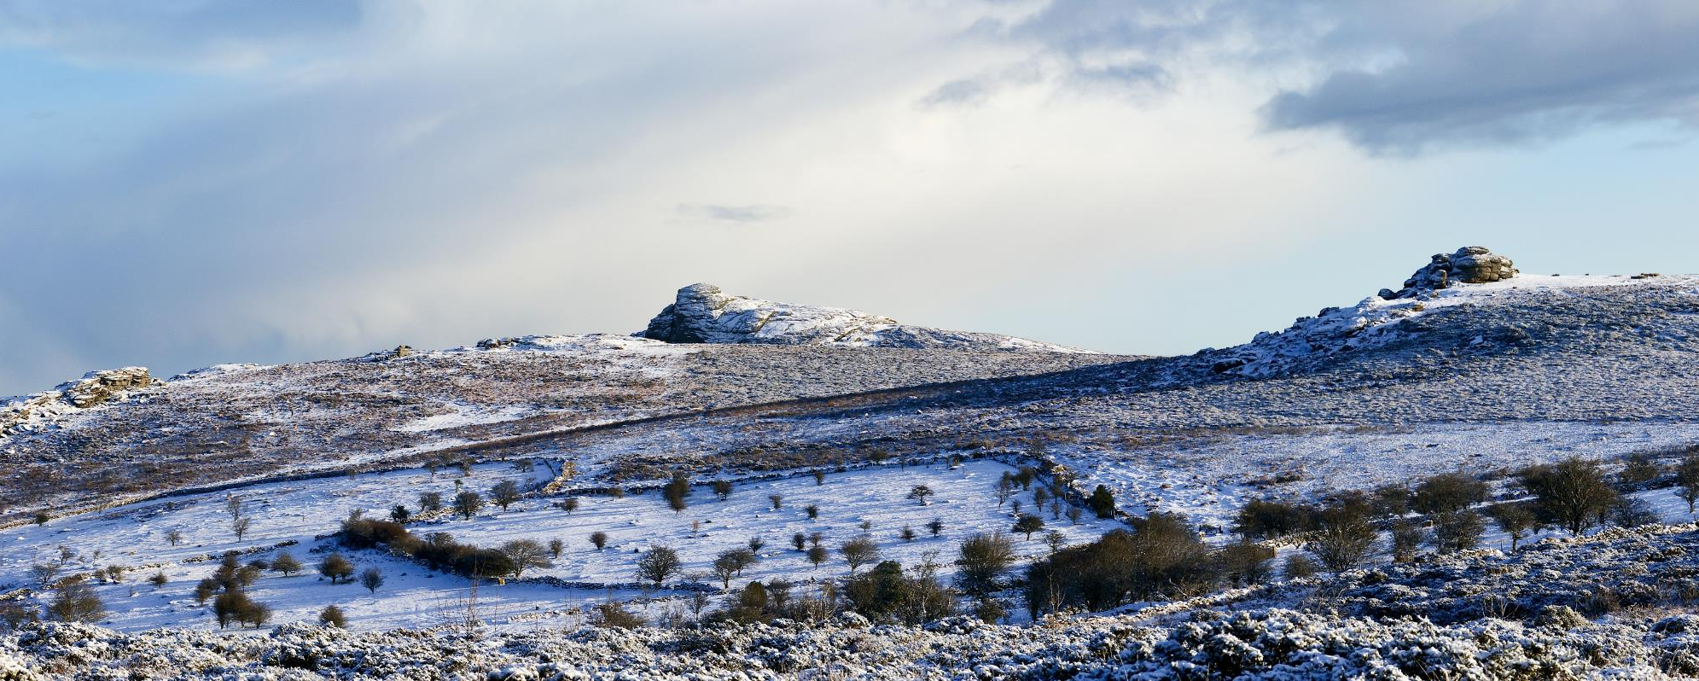
OR THIS?
(By Herbythyme - Own work, CC BY-SA 4.0, https://commons.wikimedia.org/w/index.php?curid=8814022).

Slide 22
Review:
Consider the following:
Top-down processing
when we read, we might use our world knowledge, also known as our schema, to make sense of the message. We did this when we read, the bus driver, Czech, Paris, joke 2 and joke 3 texts.
bottom-up processing
When we read, we might rely more on linguistic clues within a text to derive meaning. We did this when we read, joke 1 and the sploony urdels texts.
Top-down and bottom-up processing
Our learners should be encouraged to use both top-down and bottom-up processes as an effective way to understand a text.
Learners can draw on their schematic knowledge and apply some word attack skills to help them deduce meaning while reading. We did this when we read the misty moor text.

Slide 23
Any questions?

Slide 24
References:
Nutall, C (I996). Teaching Reading Skills in a foreign language. Macmillan Heinemann.
Thornbury, S. (2006). An A-Z of ELT. Macmillan Heinemann.
Translation: Kamila Linková. kamilaofprague.wordpress.com @kamilaofprague
https://dictionary.cambridge.org/dictionary/english/get-your-own-way
https://images.app.goo.gl/fBd9s2QGWETvZoGH6
https://www.macmillandictionary.com/dictionary/british/dark-horse
https://commons.wikimedia.org/w/index.php?curid=5133393
https://commons.wikimedia.org/w/index.php?curid=6426018
https://commons.wikimedia.org/w/index.php?curid=8814022)
https://commons.wikimedia.org/w/index.php?curid=803501
Further reading:
https://www.teachingenglish.org.uk/article/bottom
https://www.teachingenglish.org.uk/article/top-down
https://oupeltglobalblog.com/2014/07/01/bottom-up-decoding-reading-and-listening-for-the-future/
https://www.whatiselt.com/single-post/2019/07/22/What-is-Top-down-and-Bottom-up-processing
https://en.wikipedia.org/wiki/Frederic_Bartlett

Slide 25
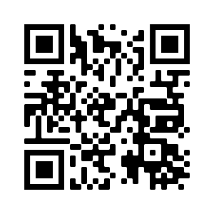
THANK YOU
Remember, this is just an overview!
However, I hope this session has caught your interest and motivates you to delve into the subject further!
eflsummerschool.wordpress.com
@EFLsummerschool

