Slide 1
A Story…
Wish constructions

Slide 2
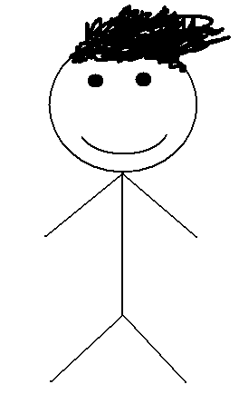
DAVE
19 YEARS OLD
Notes:
Make a background story to bring the character to life, e.g. It’s Friday afternoon, he’s just been clothes shopping and bought a new shirt, etc.

Slide 3
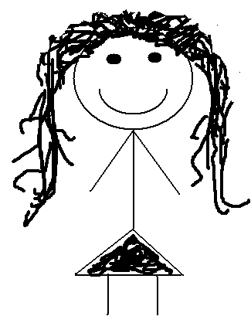
SALLY
19 YEARS OLD
Notes:
Make a background story to bring the character to life, e.g. It’s Friday afternoon, she’s just been clothes shopping and bought some new shoes, etc.

Slide 4
It’s Friday night!
Party time!
Notes:
Dave and Sally are going to go out with their friends. Make it clear that they don’t know each other.

Slide 5
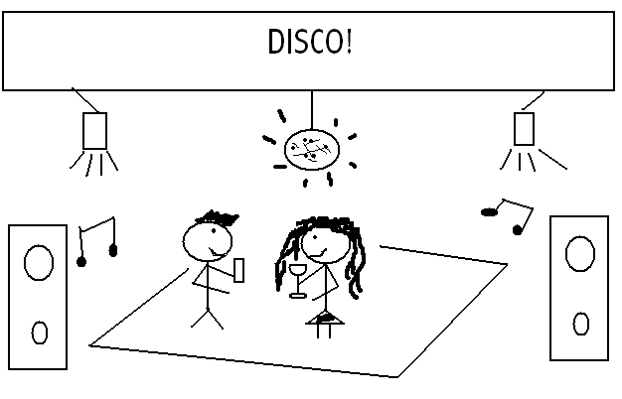
Notes:
Continue the story. This is the first time Dave and Sally have met each other.

Slide 6
Ten minutes later…
Notes:
Elicit ideas of what might happen next.

Slide 7
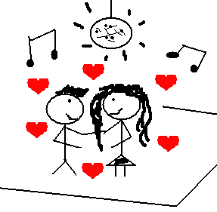
Notes:
Continue the story.

Slide 8
There’s a problem…
Notes:
Elicit ideas.

Slide 9
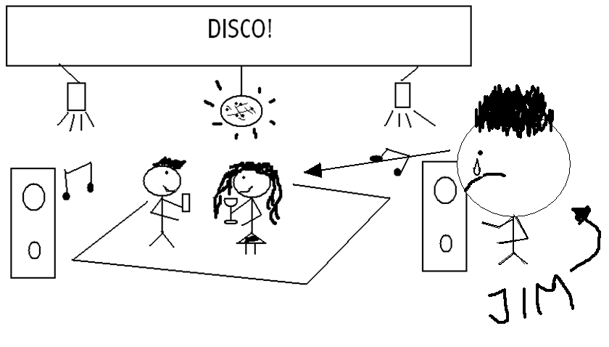
Notes:
Elicit ideas.

Slide 10
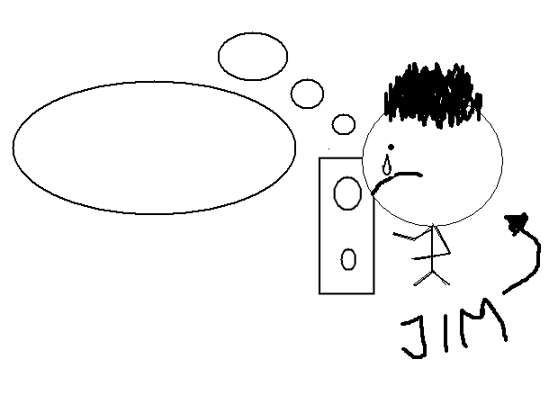
What is Jim thinking? Write some sentences starting with, ‘I wish…’
Notes:
Elicit ideas. Ask your learners to write sentences with their suggestions.

Slide 11
Jim is thinking…
I wish I had a girlfriend.

Slide 12
Wish constructions
WISH + PAST
I wish I had a girlfriend.
  Do I have a girlfriend? No
  Do I want a girlfriend? Yes
  Is this relating to the past, present or future? Present
WISH + WOULD/COULD + INFINITIVE
I wish she would/could speak to me.
  Is she speaking to me? No
  Do I want her to speak to me? Yes
  Is this relating to the past, present or future? Present
WISH + I + COULD + INFINITIVE
I wish I could speak to her.
  Am I speaking to her? No
  Do I want to speak to her? Yes
  Is this relating to the past, present or future? Present
WISH + PAST PERFECT (had + past participle)
I wish I had spoken to her first.
  Did I speak to her first? No
  Do I regret this? Yes
  Is this relating to the past, present or future? Past
Use would when we are annoyed, impatient or dissatisfied and want someone to change their behaviour.
Use could when we are talking about ability.
Instead of ‘wish’, you can use, ‘if only’. ‘If only’ is more emphatic.
Notes:
Go over the form before putting your learners into groups to check and peer correct their own utterance (slide 10) using these form notes.

Slide 13
Practice
Look at these conversations…
Notes:
Show slides 14-17.

Slide 14
I wish I was rich!
I’ve just won the lotto!

Slide 15
I wish he would say something!

Slide 16
I wish you would shut up! You’re so boring!
Blah… blah… talk… talk…

Slide 17
Practice:
Great! I got 98%.
How about you?
How was your exam?
Oh, I got 5%.
I wish I had studied harder.

Slide 18
Get ready to talk:
Think of some similar ideas.
Now have a conversation with your partner.
Tell each other what you wish.
Notes:
Put your learners into groups and allow them to develop a conversation. This could be a series of short interactions with different people or one longer conversation in pairs or small groups.

Slide 19
Review:
Consider these questions:
What have you learnt today?
Did you enjoy this lesson?

Slide 20
Any questions?

Slide 21
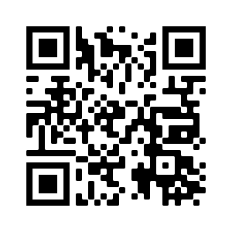
THANK YOU
eflsummerschool.wordpress.com
@EFLsummerschool

