Slide 1
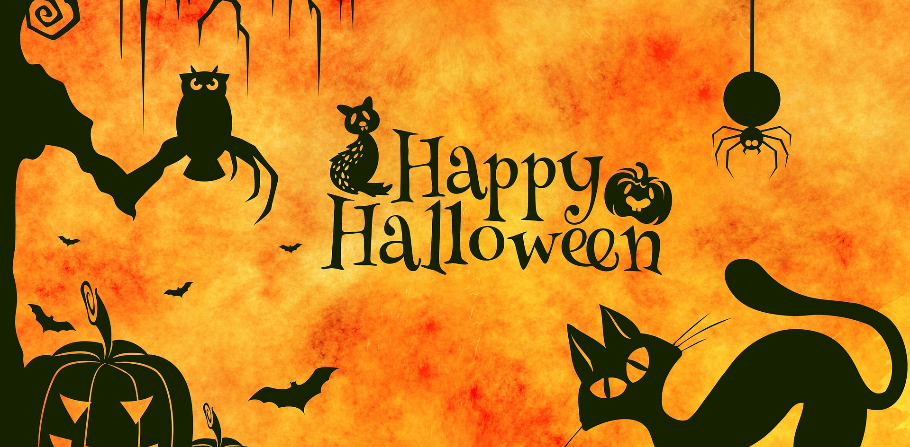
Image by Alexas_Fotos from Pixabay

Slide 2
In this lesson:
I can describe a picture using some useful language.
I can evaluate my partner´s speaking.
I can read and answer questions about Halloween.

Slide 3
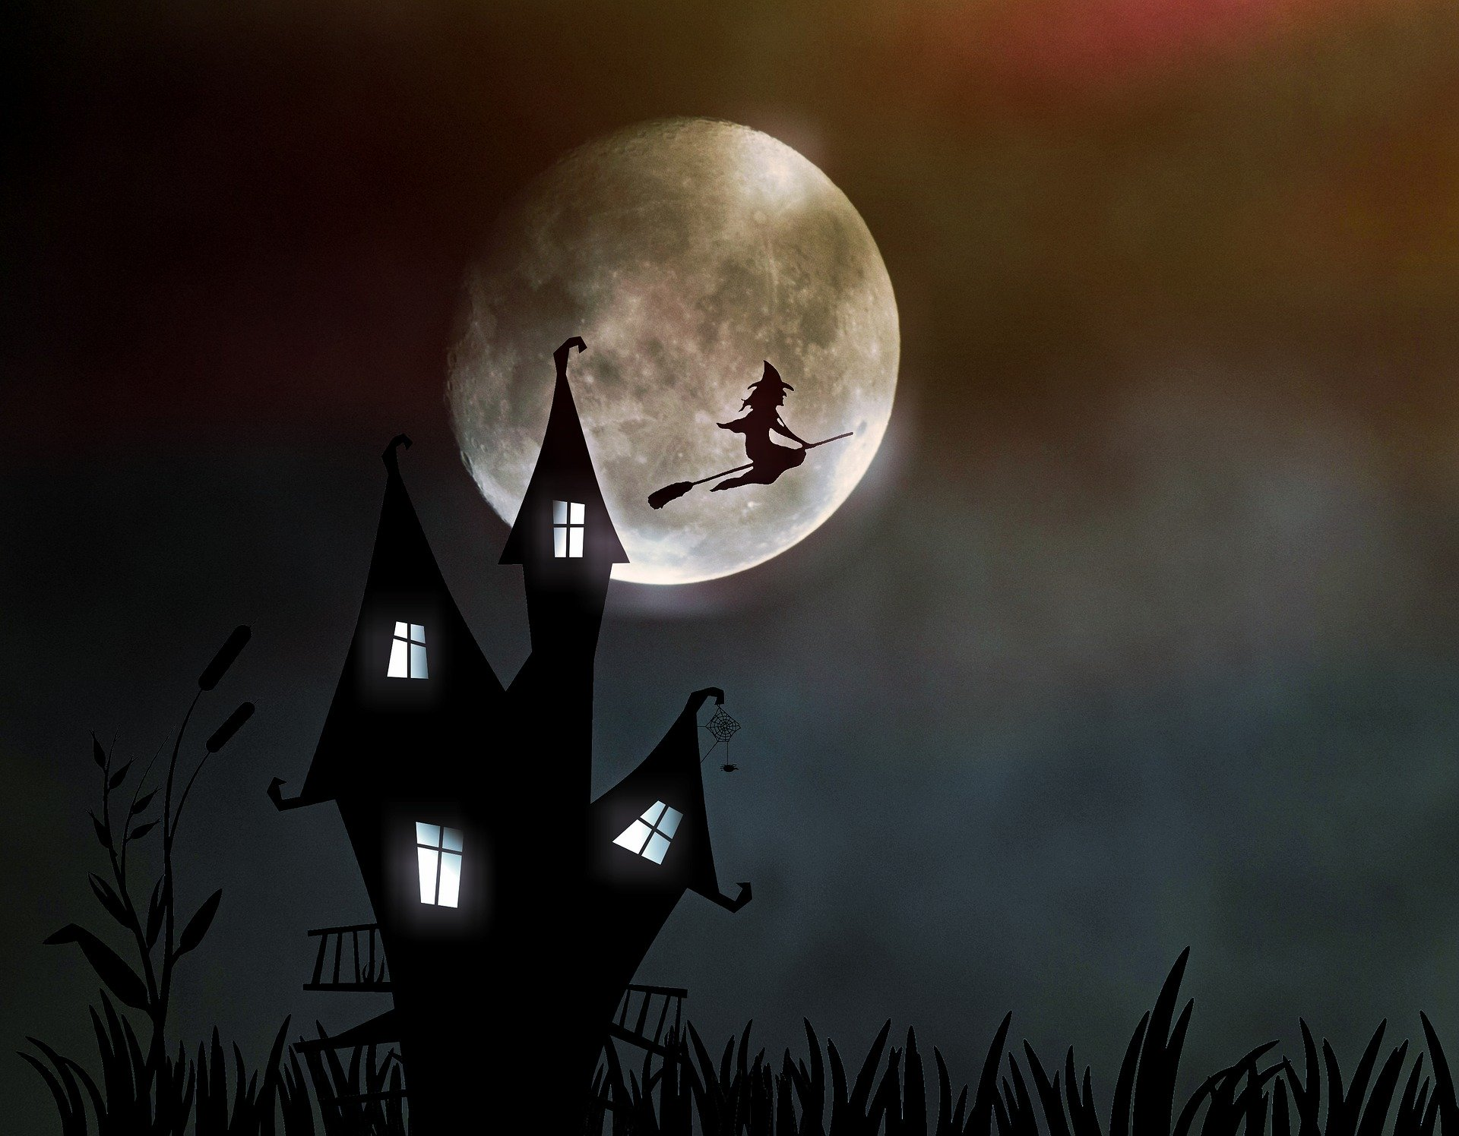
Speaking:
Tell your partner
7 Halloween words.
Image by Anja🤗#helpinghands #solidarity#stays healthy🙏 from Pixabay
Notes:
Put your learners into groups and give them 1-2 minutes to discuss.

Slide 4
Describing pictures:
You are going to describe a picture to your partner.
As you describe, your partner will evaluate your speaking.
Before we do this, think:
What language do we need to describe a picture?

Slide 5
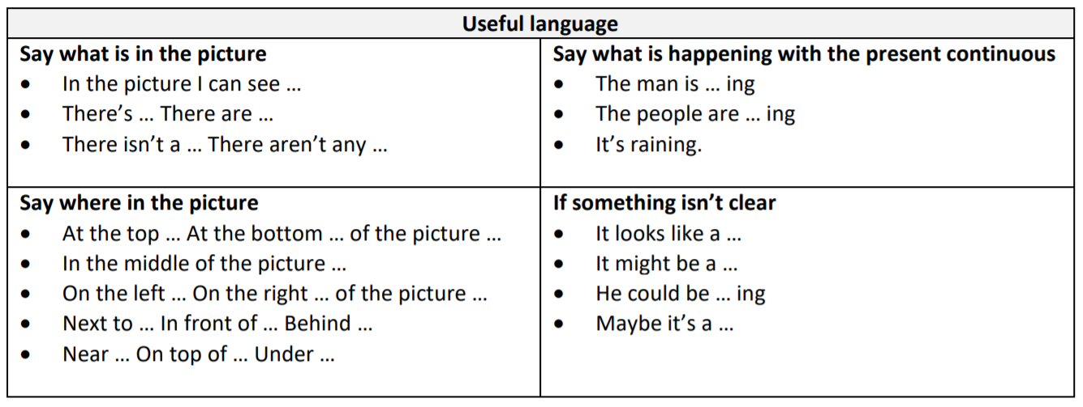
Here’s some useful language:
Notes:
Give out, Lesson. Halloween (useful language).

Slide 6
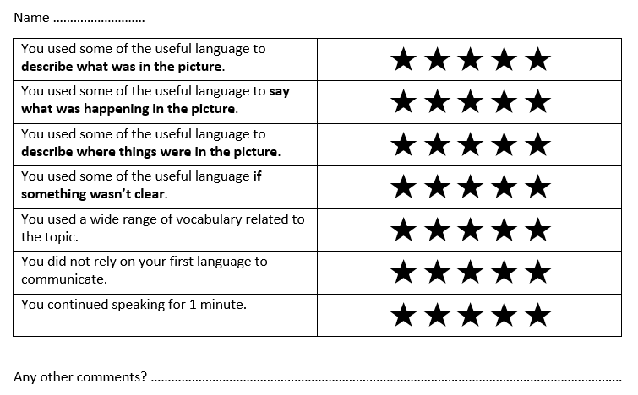
Student A:
Describe the picture. Use the Useful language to help you.
Student B:
Listen carefully and evaluate your partner using this criteria.
Notes:
Give out, Lesson. Halloween (peer evaluation form).

Slide 7
Student A, get ready to speak…

Slide 8
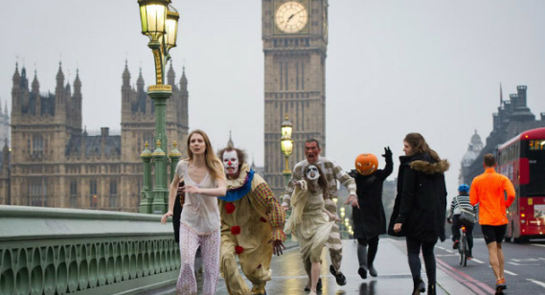
Student A:
Say what is in the picture.
Say where things are in the picture.
Say what is happening with the present continuous.
If something isn’t clear, say what it looks like or might be.
Speak for 1 minute.
Image: www.pinterest.co.uk/pin/779615385466179373
Notes:
Student A talks for 1 minute.

Slide 9
Student B:
Give your partner some feedback using the peer evaluation form.

Slide 10
Now change roles
Student B:
Describe the picture. Use the Useful language to help you.
Student A:
Listen carefully and evaluate your partner using this criteria.

Slide 11
Student B, get ready to speak…

Slide 12
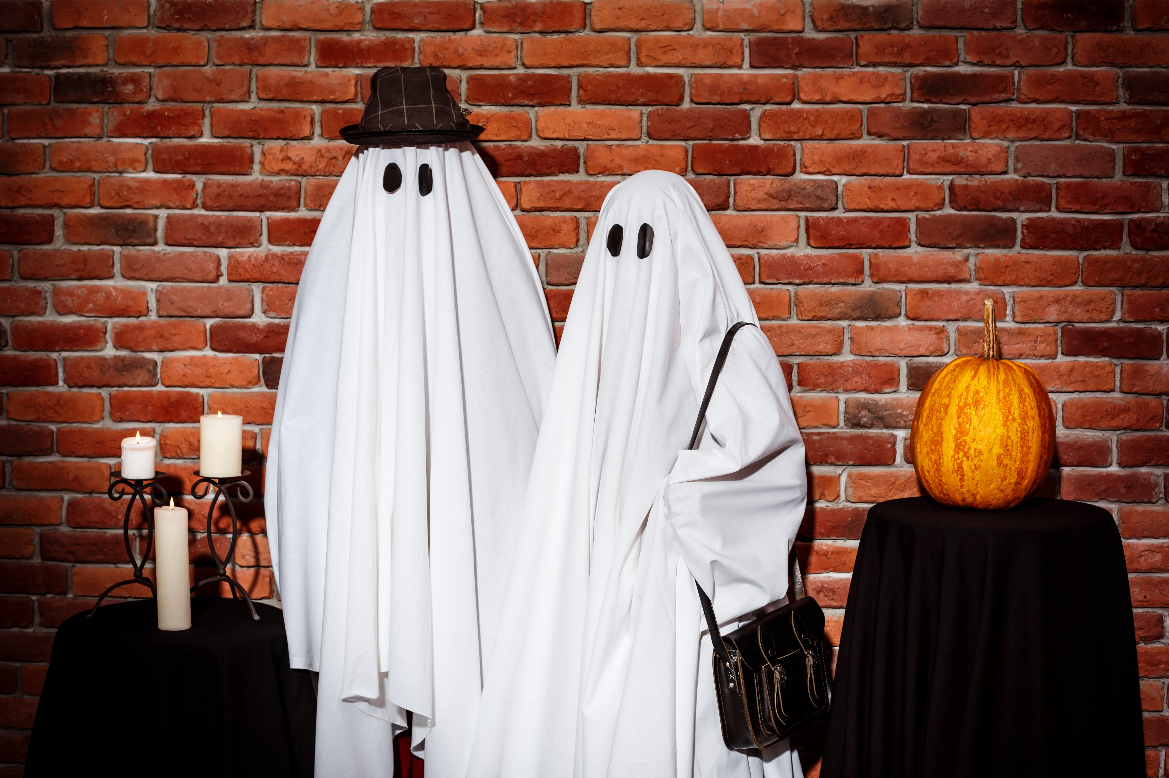
Student B:
Say what is in the picture.
Say where things are in the picture.
Say what is happening with the present continuous.
If something isn’t clear, say what it looks like or might be.
Speak for 1 minute.
Image: <a href='https://www.freepik.com/photos/party'>Party photo created by cookie_studio - www.freepik.com</a>
Notes:
Student B talks for 1 minute.

Slide 13
Student A:
Give your partner some feedback using the peer evaluation form.

Slide 14
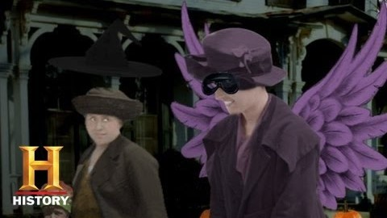
What do you know about the history of Halloween?
Watch the video and write down 5 interesting facts.
Video: https://youtu.be/zfHETu4bjgk
Bet You Didn't Know: Halloween | History
Notes:
Play the video full screen.

Slide 15
Compare your ideas with a partner.

Slide 16
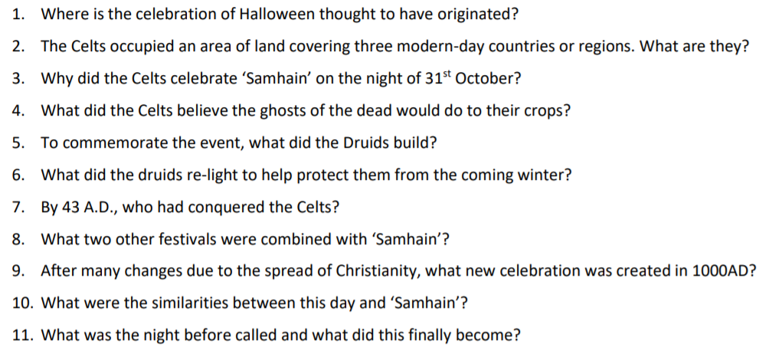
Reading:
Go to: www.history.com/topics/halloween/history-of-halloween
Answer these questions:
Notes:
Direct your learners to the text on history.com.
Give out, Lesson. Halloween (questions).

Slide 17
Check your answers with a partner.

Slide 18
Answers:
Where is the celebration of Halloween thought to have originated? The ancient Celtic festival of ‘Samhain’.
The Celts occupied an area of land covering three modern-day countries or regions. What are they? Ireland, the United Kingdom and northern France.
Why did the Celts celebrate ‘Samhain’ on the night of 31st October? They believed that on the night of 31st October, the ghosts of the dead returned to the earth.
What did the Celts believe the ghosts of the dead would do to their crops? The Celts believed the ghosts of the dead would cause damage and trouble.
To commemorate the event, what did the Druids build? The Druids built huge sacred bonfires.
What did the druids re-light to help protect them from the coming winter? The druids re-lit their hearth fires.
By 43 A.D., who had conquered the Celts? The Roman Empire.
What two other festivals were combined with ‘Samhain’? Feralia and Pomona.
After many changes due to the spread of Christianity, what new celebration was created in 1000AD? All Souls’ Day.
What were the similarities between this day and ‘Samhain’? Both had big bonfires, parades, and people dressed up in costumes as saints, angels, and devils.
What was the night before called and what did this finally become? It was called All-Hallows Eve and eventually became, Halloween.
Notes:
Check the answers as a whole class.

Slide 19
Speaking:
Are you surprised by the history of Halloween?
Are there any celebrations in your country that have a strange history?
Notes:
Class discussion.

Slide 20
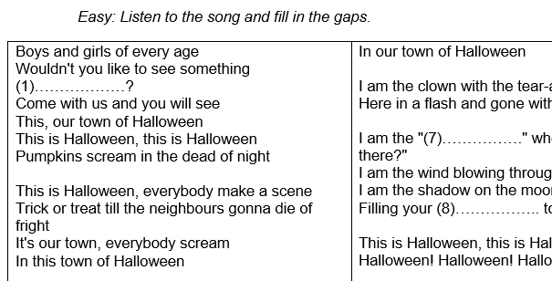
Song:
Listen to the song, This is Halloween from the film, The Nightmare before Christmas and fill in the gaps on your worksheet.
Choose an activity:
  Easy
  Medium
  Difficult
Notes:
Allow your learners to choose either, easy, medium and difficult.
Give out either easy, medium or difficult: Lesson. Halloween (lyrics - This is Halloween).
Find the song.

Slide 21
Compare you answers with a partner.
Notes:
Find the full lyrics and display them.

Slide 22
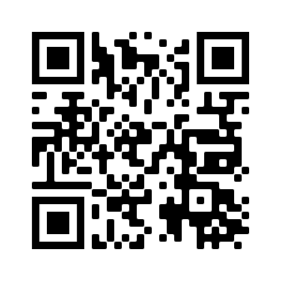
Review:
What did you learn today?
What did you enjoy doing?
eflsummerschool.wordpress.com
@EFLsummerschool

