Slide 1
Sergey Ananov:
Two days on ice with three polar bears

Slide 2
We will:
Set up a homework activity (this lesson).
Watch a video clip about a man called Sergey Ananov.
read what happened to Sergey Ananov for homework.
Create a comic strip to retell the story (next lesson).

Slide 3
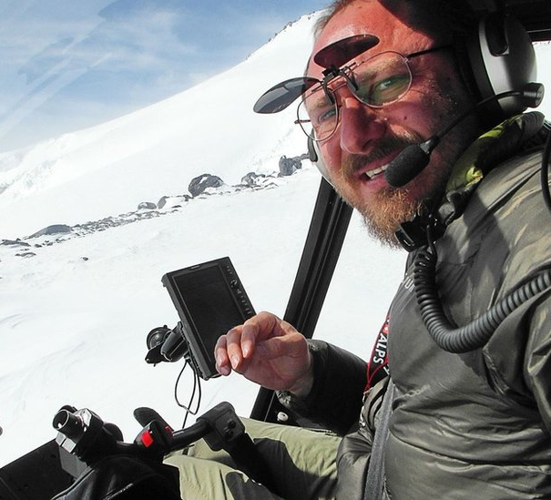
Look at this picture:
you are going to read a story about this man, Sergey Ananov.
The story is called, Sergey Ananov: Two days on ice with three polar bears.
What do you think happened?
(Photo: Sergey Ananov https://www.bbc.co.uk/news/magazine-34281218)

Slide 4
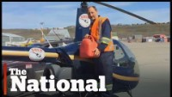
Watch:
now watch a news clip about Sergey Ananov’s adventure.
As you watch, check if your ideas were correct.
Make a note of any other interesting facts.

Slide 5
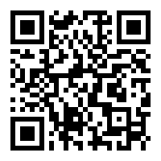
Reading:
Write down this link or scan the QR code:
  www.bbc.co.uk/news/magazine-34281218
Or find the article by searching by the title:
Sergey Ananov: Two days on ice with three polar bears

Slide 6
Read the text at home:
Write down the questions or take a picture of this slide.
reading:
reading time: 15-20 minutes.
read the text at least once.
After reading:
Did you enjoy the story?
Did you find any difficult or unusual words or phrases?
How did the story make you feel?
What are your thoughts?

Slide 7
Welcome back! Did you read the story?
Sergey Ananov:
Two days on ice with three polar bears

Slide 8
Speaking:
Discuss the story with a partner.
What makes this story compelling?
What motivates people like Sergey Ananov to attempt these types of challenges?
Why are stories like this so newsworthy?

Slide 9
Create a comic strip to tell Sergey Ananov’s story:
In groups:
divide the story into stages.
Discuss what pictures would best convey each stage of the story.
Create a draft and discuss what text might need to be added.
Draw the pictures using the ‘comic strip’ template.
Cut out each picture and put them in order. Don’t stick them down.
Ask for feedback from other groups.
Make any final changes to your comic strip. Stick the pictures down.
Display your comic strip for others to read.
Notes:
Give out copies of the ‘comic strip’ template.

Slide 10
References:
www.bbc.co.uk/news/magazine-34281218
https://youtu.be/5OeWmlhEk6c

Slide 11
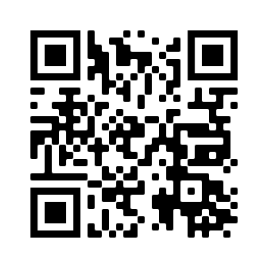
THANK YOU
eflsummerschool.wordpress.com
@EFLsummerschool

